Slide 1
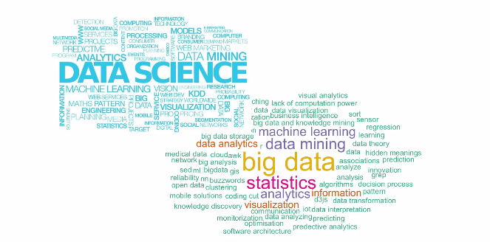
Data Science – Day 6

Slide 2
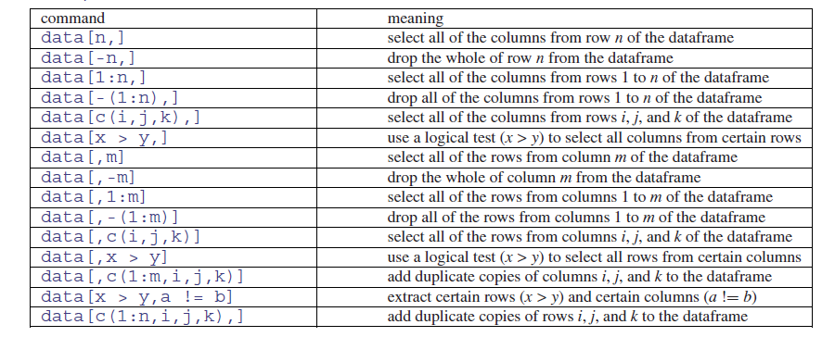

Slide 3
Response variable ~ explanatory variable(s)
Linear regression is one of the most commonly used predictive modelling techniques. The aim of linear regression is to find a mathematical equation for a continuous response variable Y as a function of one or more X variable(s). So that you can use this regression model to predict the Y when only the X is known.

Slide 4


